Slide 1
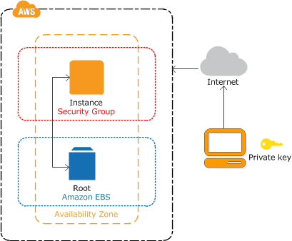
Getting Started with Amazon EC2 Linux Instances
An instance is a virtual server in the AWS cloud
When you launch your instance
secure it by specifying a key-pair and security group
network it by specify a virtual private cloud and an elastic IP

Slide 2
Overview
Create Key Pair
Create Virtual Private Cloud
Create Security Group
Create Elastic IP
Launch Instance

Slide 3
Create Key Pair
Amazon EC2 uses public–key cryptography to encrypt and decrypt login information.
Public–key cryptography uses a public key to encrypt a piece of data, such as a password, then the recipient uses the private key to decrypt the data.
The public and private keys are known as a key pair.
Amazon EC2 stores the public key only, and you store the private key.
Anyone who possesses your private key can decrypt your login information, so it's important that you store your private keys in a secure place.

Slide 4
Create Virtual Private Cloud (VPC)
A virtual private cloud (VPC) is a virtual network dedicated to your AWS account.
It is logically isolated from other virtual networks in the AWS cloud.
You can launch your AWS resources, such as Amazon EC2 instances, into your VPC.
You can configure your VPC; you can select its IP address range, create subnets, and configure route tables, network gateways, and security settings.
A subnet is a range of IP addresses in your VPC.
You can launch AWS resources into a subnet that you select.
Use a public subnet for resources that must be connected to the Internet, and a private subnet for resources that won't be connected to the Internet.
An Internet gateway enables your instances to connect to the Internet through the Amazon EC2 network edge.

Slide 5
Create a Security Group
Security groups act as a firewall for associated instances, controlling both inbound and outbound traffic at the instance level.
The rules of a security group control the inbound traffic that's allowed to reach the instances that are associated with the security group and the outbound traffic that's allowed to leave them.

Slide 6
Create Elastic IP
An Elastic IP address is a static, public IP address designed for dynamic cloud computing.
You can associate an Elastic IP address with any instance or network interface for your VPC.
With an Elastic IP address, you can mask the failure of an instance by rapidly remapping the address to another instance in your VPC.
Note that the advantage of associating the Elastic IP address with the network interface instead of directly with the instance is that you can move all the attributes of the network interface from one instance to another in a single step.

Slide 7
Launch an Instance
Assign
Key Pair
Virtual Private Cloud
Security Group
Elastic IP

